Slide 1
Negotiation

Slide 2
Selling and Negotiating
Selling and negotiating are fundamentally different things
Selling is about identifying the needs of a buyer and then offering what fits him/her best
Negotiation does not start early; it is a continuum of selling process and agreeing the terms of the deal. Negotiation happens when there is a mutual commitment towards sales

Slide 3
Negotiation
Negotiation is a process to reach a mutually acceptable agreement that satisfies each party’s interests
Negotiation rises up satisfaction, drives value and makes people believe they pay fair price

Slide 4
Fairness in Negotiation
Solution is a win solution as long as people perceive it as fair/beneficial for them.

Slide 5
Do not bargain over position
When you lock yourself to one position, it is difficult then to change your opinion in order not to ‘lose your face’
Focus on interests
Bargaining over position leads to no agreement or an agreement that is less satisfactory for both parties

Slide 6
Right to negotiate
Never ask “Can we negotiate?”
All people in the world have a dignity and right to negotiate.

Slide 7
BATNA and ZOPA
Best Alternative To a Negotiated Agreement
BATNA determines each side’s bottom line or walk-away positions
ZOPA is an agreement within the range where both parties would benefit more than from their alternative options
Identifying ZOPA is critical to successful results of negotiation, but it takes time

Slide 8
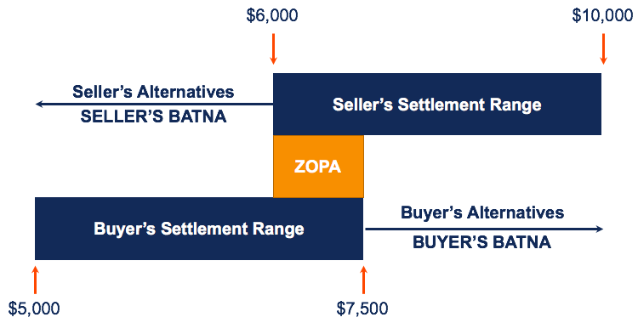

Slide 9
Combination of Hard skills and Soft skills
Communication skill is very important.
Listen carefully, do not interrupt, summarize what has been said or ask questions if something is not clear.
Focus on people and their interests. Apply both hard and soft skills
Silence is very powerful

Slide 10

Q&A

